Slide 1
Analysing customer churn
BANK CUSTOMER DATA
U.V. Sri Harsha

Slide 2
Data Description
The Data is basically European Banking data considering France , Spain and Germany countries business.
The Basic Problem is to identify at what situation churning/ leaving the bank and what is the customer age group mostly churning happened.
The Differentiators are Age , Rate of churning , Gender, Country , Credit card status and Bank balance.
Differentiators helped us to Find the insights and also find lot of clear cut information.

Slide 3
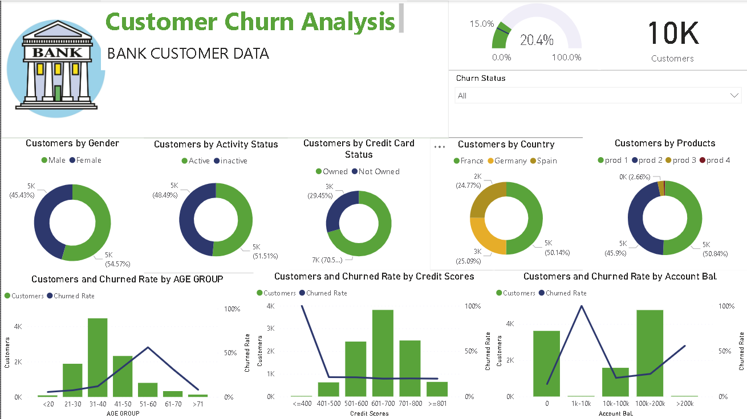
Churn Analysis

Slide 4
Churn Rate by Male Gender
The Male activity status is around 48% Gents are inactive and 52% of females are active in the bank also 70% of males having credit cards.
Coming to churn rate when males taken into consideration the total churned rate would be 25.1% and when we take the out age factor then most churned would be around 30-50 years
When we take Churned rate as per credit score most of the churned rate in males having credit scores <=500
Coming to Bank balance most females having 1k to 10k are most churned.

Slide 5
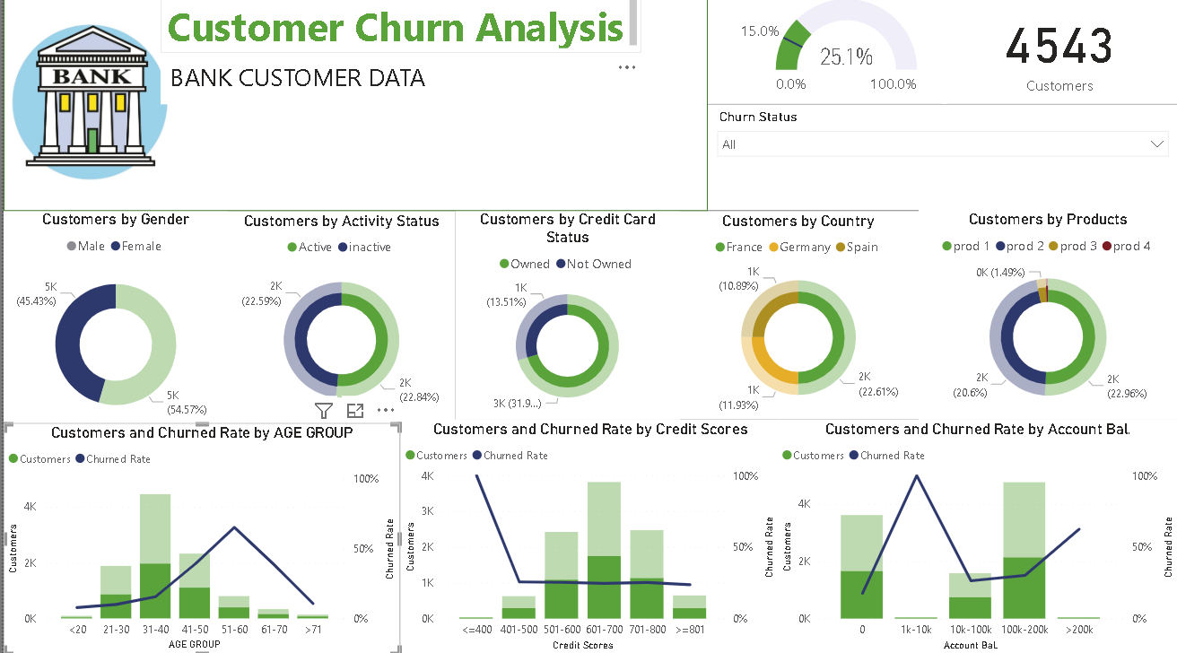
Churn Rate by Male Gender

Slide 6
Churn Rate by Female Gender
The Male activity status is around 51% ladies are inactive and 49% of females are active in the bank also 71% of females having credit cards.
Coming to churn rate when females taken into consideration the total churned rate would be 16.5% and when we take the out age factor then most churned would be around 35-45 years
When we take Churned rate as per credit score most of the churned rate in females having credit scores <=400
Coming to Bank balance most females having above 200k are most churned.

Slide 7
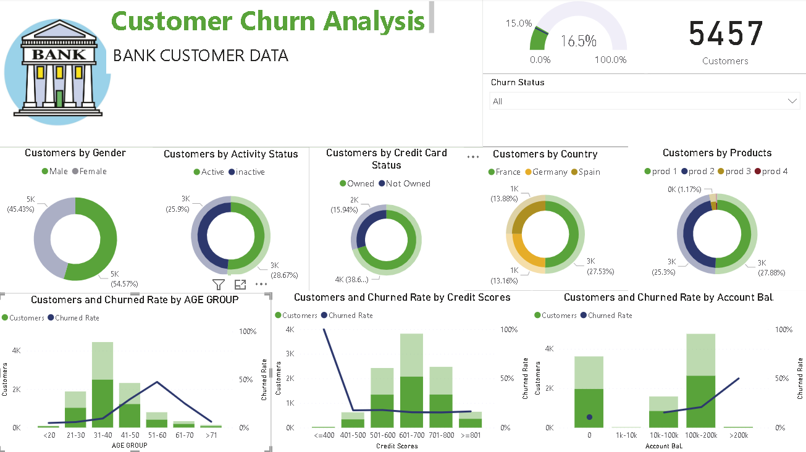
Churn Rate by Female Gender

Slide 8
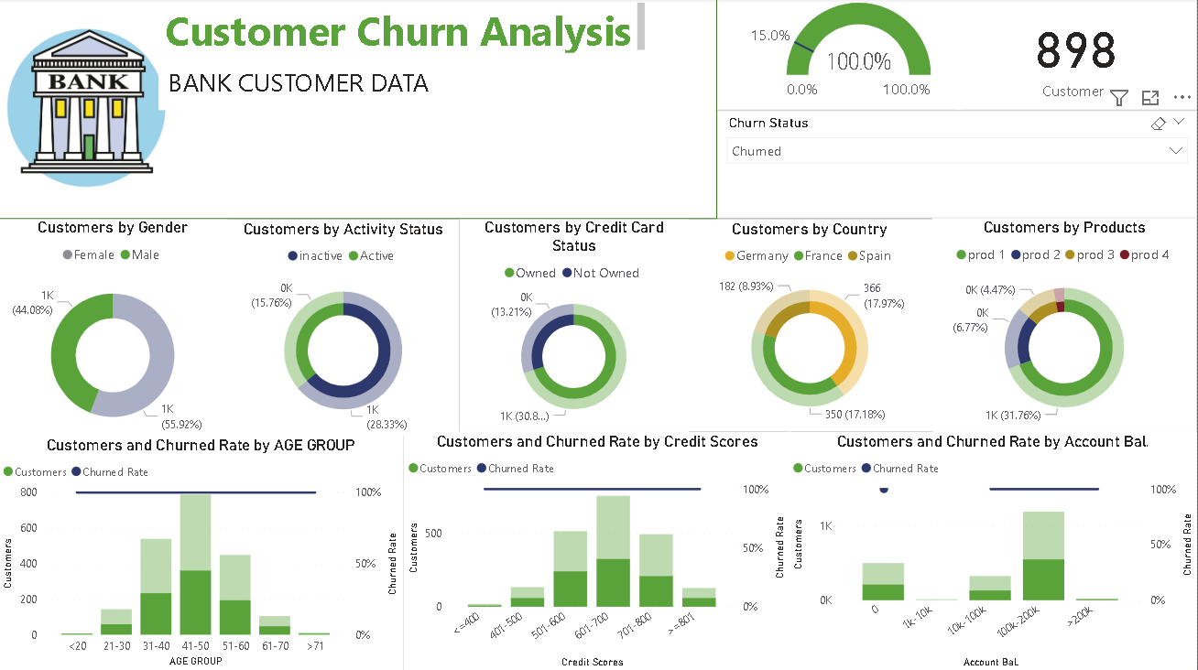
Rate of churned male

Slide 9
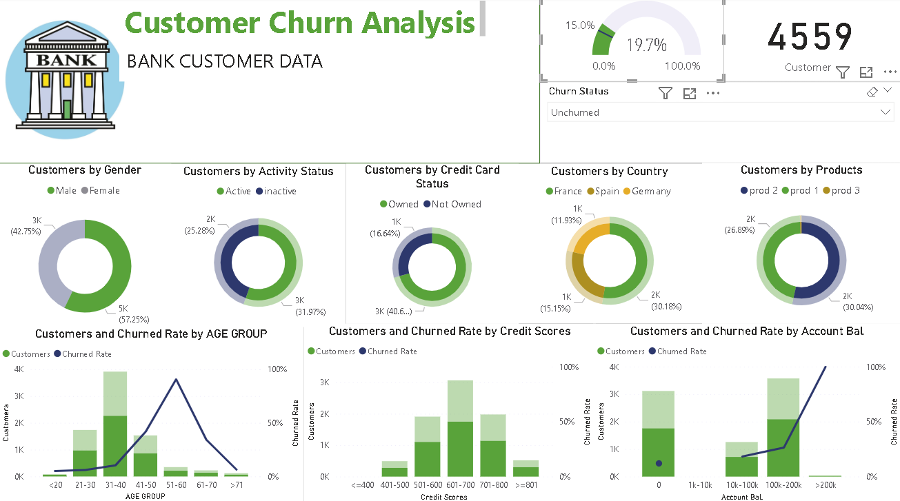
Unchurn Rate by male Gender

Slide 10
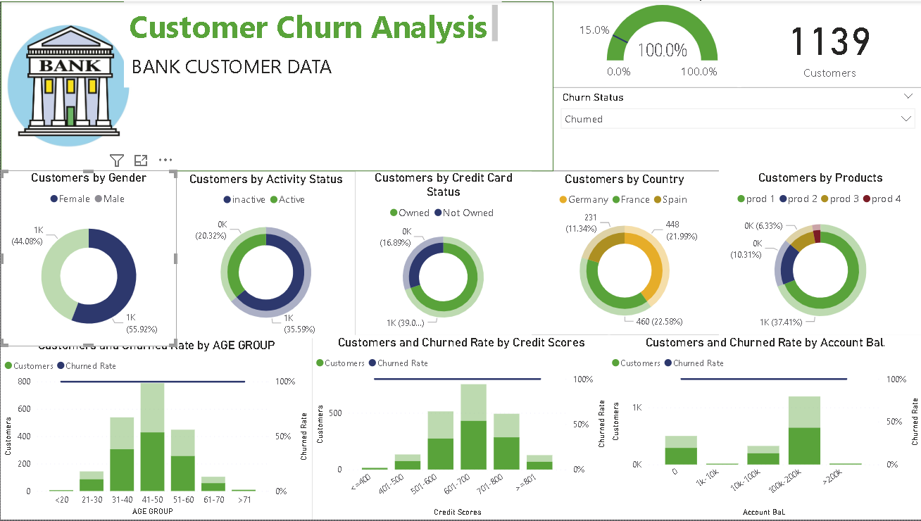
Churn Rate by female Gender

Slide 11
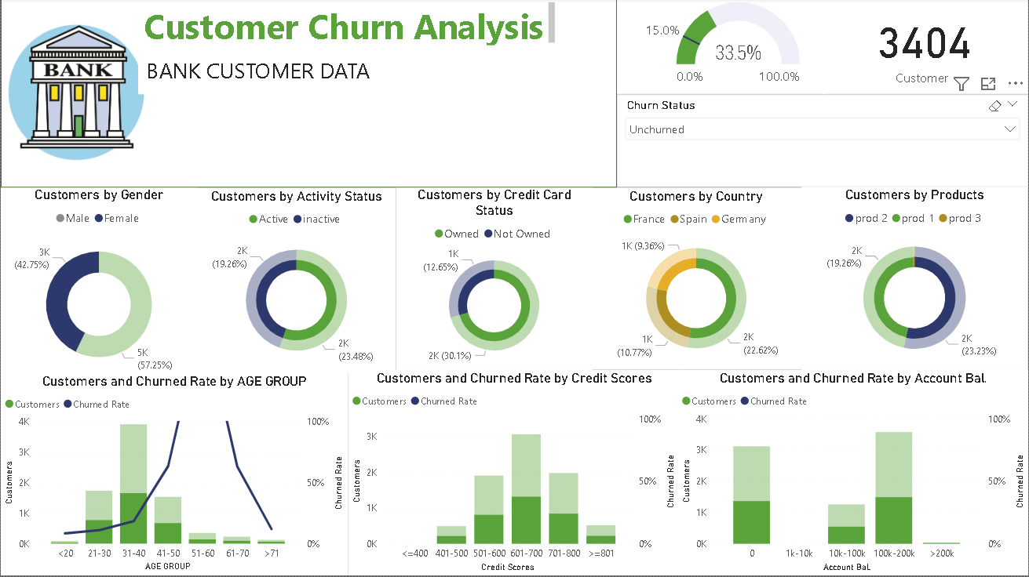
Unchurn Rate by female Gender

Slide 12
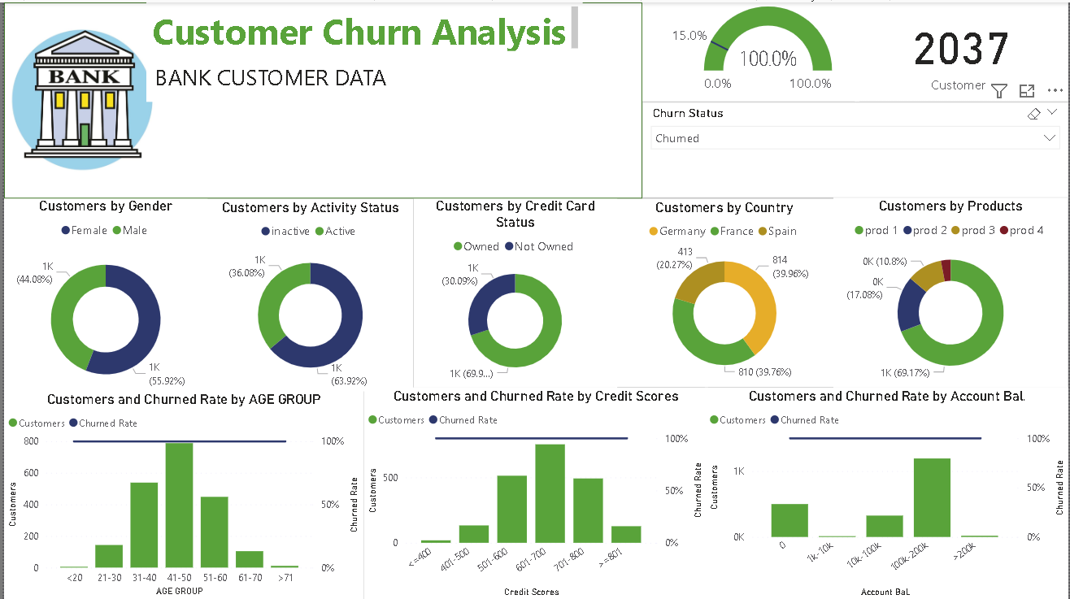
Churn Rate irrespective of gender

Slide 13
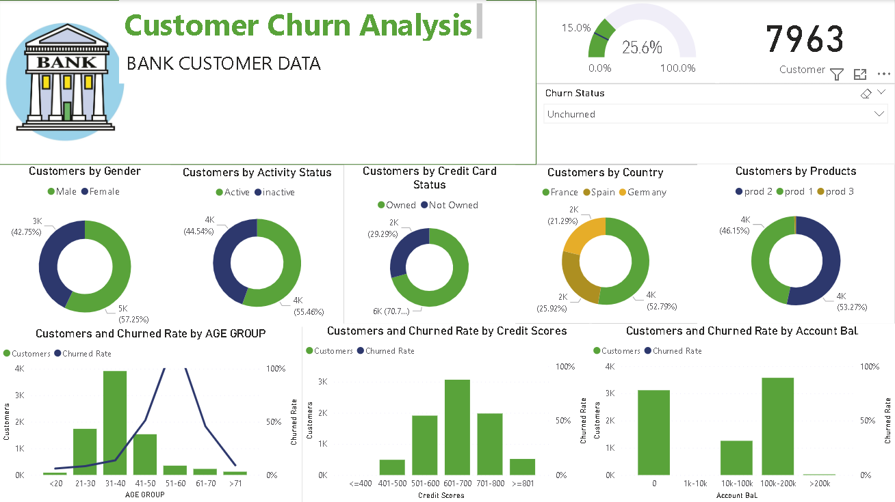
Churn Rate irrespective of gender

Slide 14
The End

